Slide 1
Cloud Integrated Sudden Infant Death Syndrome Monitoring
Team Name: POWER EXPLORERS
Team Members: N Padmini Reddy
D Saanidhya

Slide 2
PROBLEM STATEMENT
Sudden Infant Death Syndrome(SIDS) is also known as COT/CRIB disease which is sudden or unexplainable death during 1st year of life.
Because of the seemingly nature of this condition there are no.of risk factors that seemed in cruelly with getting SIDS.
But there is no clear mechanism or cause that’s been identified.
Risk factors could be based on how infants sleep or may be because of a low birth weight or born prematurely or because of lack of parental care during pregnancy.
To minimize the risk of SIDS the infants should kept sleep on their back, should not be exposed to pollution and should be breastfed possible.

Slide 3
ABSTRACT
SIDS is a disease of unkown cause. Despite recent decreases in the incidence of SIDS, SIDS is still responsible for more infant deaths in the United States than any other cause of death during infancy beyond the neonatal period.
SIDS is defined as:
“The sudden death of an infant under 1 year of age,which remains unexplained after a thorough case investigation, including performance of a compete autopsy, examination of death scene, and review of the clinical history.

Slide 4
Project working process
Sudden Infant Death Syndrome is one of the major causes of death among infants during their sleep. The Wearable IoT Device acts as a wireless sensor node integrated with a Chest Belt and it has the capacity to monitor the following parameters:
Body temperature
Heartbeat rate
Body position
After a minimal data processing, this set of information is sent to the Gateway, via Bluetooth technology. Here the mobile app is acting as the gateway between device and cloud platform. If any parameters exceed the threshold values then a sound alert will generate. The body temperature, pulse rate and position data can be monitored through mobile App. the values are sent to cloud through mobile App and alerts are generated if there is any emergency.

Slide 5
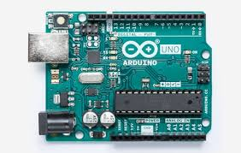
Components used
Arduino Uno
Microcontroller: ATmega328
Operating Voltage: 5V
Digital I/O Pins: 14 (of which 6 provide PWM output)
Analog Input Pins: 6
Flash Memory: 32 KB of which 0.5 KB used by bootloader
EEPROM: 1 KB (ATmega328)
SRAM: 2 KB (ATmega328)
Clock Speed: 16 MHz

Slide 6
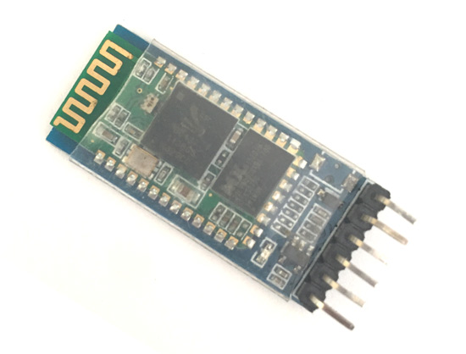
Bluetooth HC-05
Bluetooth protocal: Bluetooth Specification v2.0+EDR
Frequency: 2.4GHz ISM band
Speed: Asynchronous: 2.1Mbps(Max) / 160 kbps, Synchronous: 1Mbps/1Mbps
Profiles: Bluetooth serial port
Power supply: +3.3VDC 50mA
Working temperature: -20 ~ +75Centigrade
Dimension: 26.9mm x 13mm x 2.2 mm

Slide 7
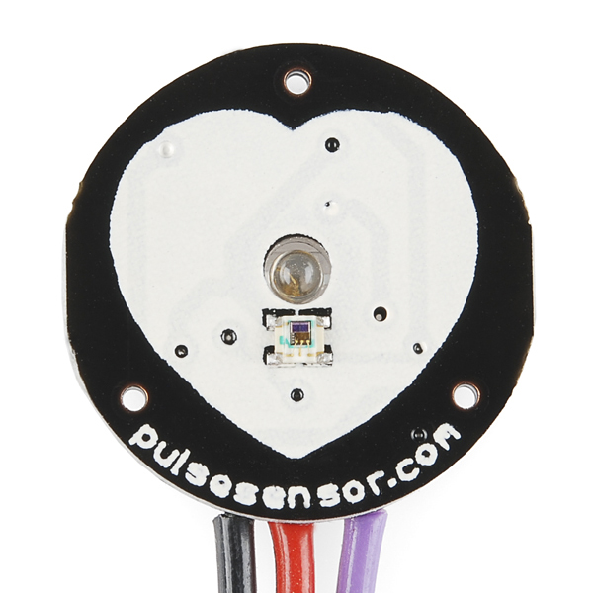
Pulse Sensor
Biometric Pulse Rate or Heart Rate detecting sensor
Plug and Play type sensor
Operating Voltage: +5V or +3.3V
Current Consumption: 4mA
Inbuilt Amplification and Noise cancellation circuit.
Diameter: 0.625”
Thickness: 0.125” Thick

Slide 8
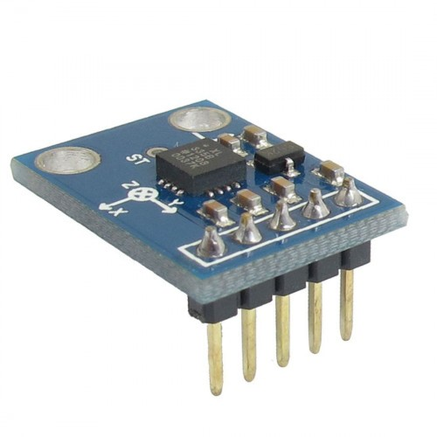
Accelerometer
3-axis sensing Small, low profile package 4 mm × 4 mm × 1.45 mm LFCSP
Low power : 350 μA (typical)
Single-supply operation: 1.8 V to 3.6 V 10,000 g
shock survival
Excellent temperature stability

Slide 9
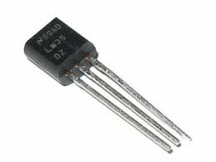
Temperature sensor
Calibrated directly in Celsius (Centigrade)
Linear + 10-mV/°C scale factor
0.5°C ensured accuracy (at 25°C)
Rated for full −55°C to 150°C range
Suitable for remote applications

Slide 10
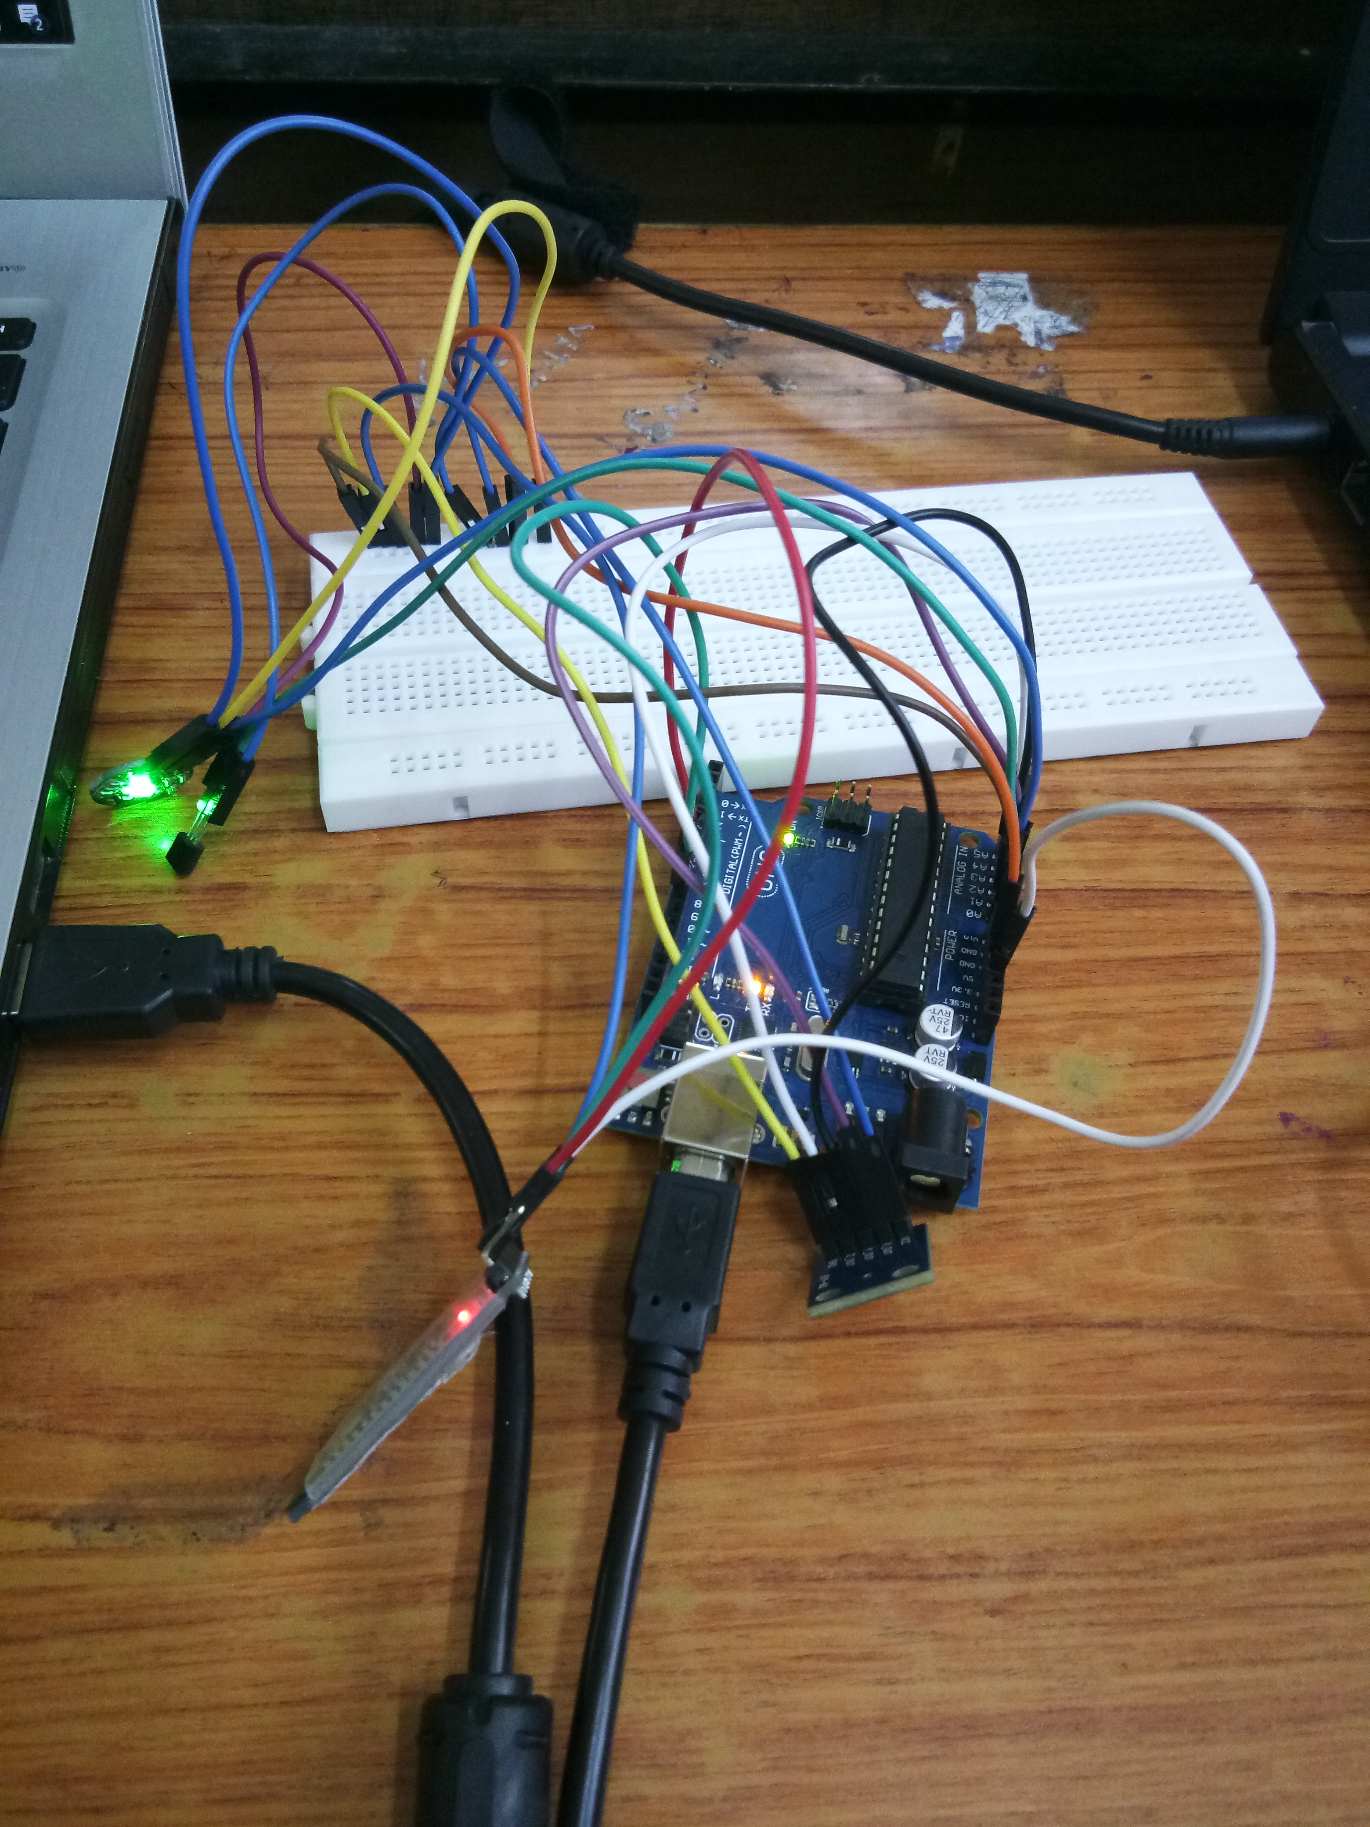

Slide 11
CODE
#include <SoftwareSerial.h>
SoftwareSerial mySerial(8,9);//rx,tx
// VARIABLES
int pulsePin = A1; // Pulse Sensor purple wire connected to analog pin 0
int tempPin = A0; // Temperature Sensor connected to analog pin 1
int blinkPin = 13; // pin to blink led at each beat
int sensorValue[5] = {0,0,0,0,0};
char inbyte = 0;
String data;
// these variables are volatile because they are used during the interrupt service routine!
volatile int BPM; // used to hold the pulse rate
volatile int Signal; // holds the incoming raw data
volatile int IBI = 600; // holds the time between beats, must be seeded!
volatile boolean Pulse = false; // true when pulse wave is high, false when it's low
volatile boolean QS = false; // becomes true when Arduoino finds a beat.
void setup(){
pinMode(blinkPin,OUTPUT); // pin that will blink to your heartbeat!
Serial.begin(9600); // we agree to talk fast!
mySerial.begin(9600); //
interruptSetup(); // sets up to read Pulse Sensor signal every 2mS

Slide 12
void loop(){
getSensorValues();
sendAndroidValues();
delay(1000); // take a break
}
void getSensorValues()
{
// read the analog in value to the sensor array
sensorValue[0] = ( 5 * analogRead(tempPin) * 100.0) / 1024.0;
Serial.println(sensorValue[0]);
if (QS == true){ // Quantified Self flag is true when arduino finds a heartbeat
Serial.print("Signal=");
Serial.println(Signal); // Print pulse sensor raw data
Serial.print("HeartBeat=");
Serial.println(BPM); // Print BPM (beats per Minut)
Serial.print("Time Interval=");
Serial.println(IBI); // Print IBI (Interval between beats)
sensorValue[1] = BPM; // read the BPM to the sensor array
QS = false; // reset the Quantified Self flag for next time
}
sensorValue[2]=analogRead(A2);
sensorValue[3]=analogRead(A3);
sensorValue[4]=analogRead(A4);
}
void sendAndroidValues()
{
data="#";
data+= sensorValue[0];
data+=",";
data+= sensorValue[1];
data+=",";
data+= sensorValue[2];
data+=",";
data+= sensorValue[3];
data+=",";
data+= sensorValue[4];
data+="+";
Serial.println("data is");
Serial.println(data);
mySerial.println(data);
}

Slide 13
SOFTWARE(S) USED
Arduino IDE
MIT App Inventor

Slide 14


